Slide 1

CAP 6317/4773: Social Media Mining
Lecture 3: Centrality Measures
Raiyan Abdul Baten, Ph.D.
January 16, 2024
Notes:
This is a story about ideas. To set the stage, I’ll start with this question

Slide 2
Recap

Slide 3
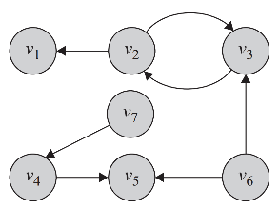
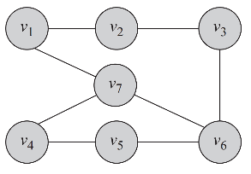
Undirected Graph
Directed Graph
Facebook friends
Members of the same facebook group/subreddit
Co-located in the same zip code
Co-authored a paper
Twitter follower/followee
Cited the other person’s paper
Took creative inspiration from another person
Gave another person feedback

Slide 4
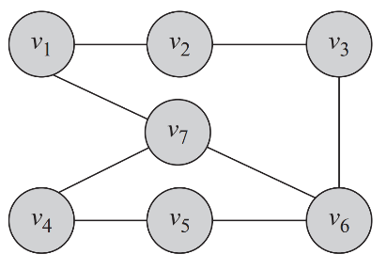



e₁
e₂
e₃
e₈
e₅
e₄
e₆
e₇
G(V,E) denotes our undirected graph, where V is the set of nodes and E is the set of edges
|V| and |E| denote sizes of the respective node and edge sets

Slide 5
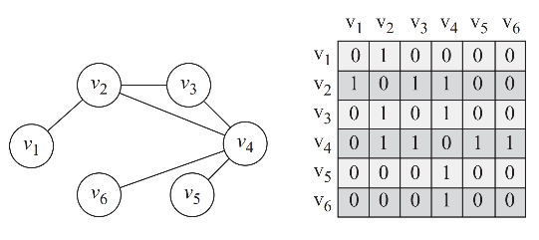
Adjacency Matrix
A 2D matrix, A, with rows and columns denoting nodes
A value of 1 in position A_{i,j} denotes that v_{i} is connected to v_{j}
All other entries are 0

Slide 6
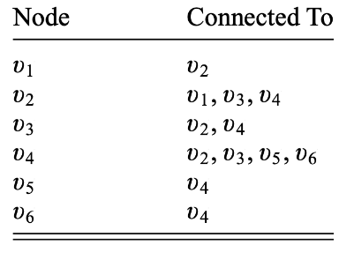
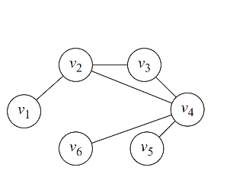
Adjacency List

Slide 7
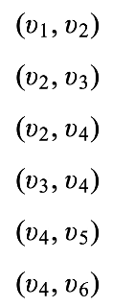
Edge List

Slide 8
Who are the most important people in the network?

Slide 9
Social Science
Network/computational Science
Let us not forget
Computer science
Machine learning
Ethnography
Mathematics
Optimization
And more!
Social Media Mining
Statistics and Data Mining

Slide 10
Before mining, decide what you mean by ‘important’
I’m important if
I follow a lot of people? [maybe a bad idea]

Slide 11
Before mining, decide what you mean by ‘important’
I’m important if
I follow a lot of people? [maybe a bad idea]
A lot of people follow me? [more reasonable]

Slide 12
Before mining, decide what you mean by ‘important’
I’m important if
I follow a lot of people? [maybe a bad idea]
A lot of people follow me? [more reasonable]
People who are connected to me are themselves important (e.g., widely followed)? [makes even more sense]

Slide 13
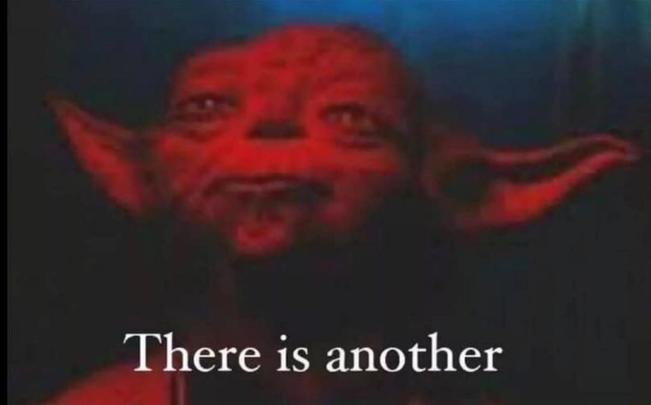

Slide 14
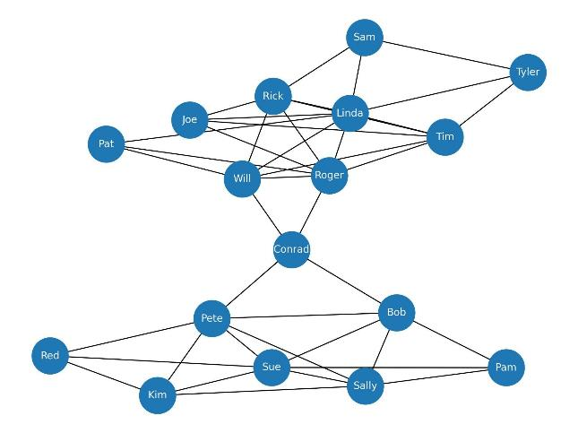
Data collected by Prof. David Krackhardt of Carnegie Mellon University

Slide 15
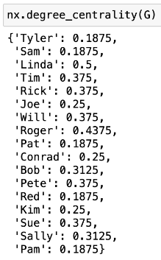

Degree Centrality
Linda has the most number of connections
Data collected by Prof. David Krackhardt of Carnegie Mellon University

Slide 16
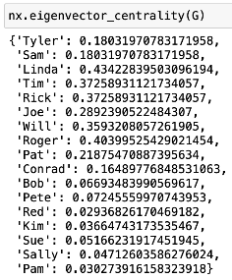
Eigenvector Centrality
Linda also has the most well-connected friends
Data collected by Prof. David Krackhardt of Carnegie Mellon University

Slide 17
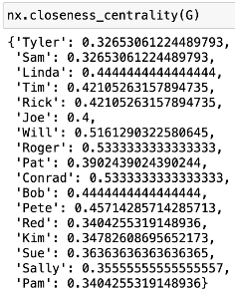
Closeness Centrality
But Roger can reach everyone else at the lowest average number of hops
Data collected by Prof. David Krackhardt of Carnegie Mellon University

Slide 18
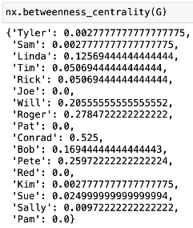
Betweenness Centrality
Conrad is holding the two communities together!
Data collected by Prof. David Krackhardt of Carnegie Mellon University

Slide 19
Degree Centrality
The number of edges connected to a node
Number of friends on Facebook
Number of followers/ re-tweeters on Twitter
Number of people ‘upvoting’ you on Reddit

Slide 20
Degree Centrality
Eigenvector Centrality
The number of edges connected to a node
The measure of the extent to which a node is connected to influential other nodes
Number of friends on Facebook
Number of followers/ re-tweeters on Twitter
Number of people ‘upvoting’ you on Reddit
Elon Musk retweeting you might make you more ‘important’ that Raiyan retweeting you ¯\_(ツ)_/¯

Slide 21
Degree Centrality
Eigenvector Centrality
Closeness Centrality
The number of edges connected to a node
The measure of the extent to which a node is connected to influential other nodes
The average of the shortest distances to all other nodes in the graph
Number of friends on Facebook
Number of followers/ re-tweeters on Twitter
Number of people ‘upvoting’ you on Reddit
Elon Musk retweeting you might make you more ‘important’ that Raiyan retweeting you ¯\_(ツ)_/¯
Pick this person for propagating information across the community! [2]

Slide 22
Degree Centrality
Eigenvector Centrality
Closeness Centrality
Betweenness Centrality
The number of edges connected to a node
The measure of the extent to which a node is connected to influential other nodes
The average of the shortest distances to all other nodes in the graph
The extent to which a particular node lies on the shortest path between other nodes
Number of friends on Facebook
Number of followers/ re-tweeters on Twitter
Number of people ‘upvoting’ you on Reddit
Elon Musk retweeting you might make you more ‘important’ that Raiyan retweeting you ¯\_(ツ)_/¯
Pick this person for propagating information across the community! [2]
Bridging nodes, brokers
In an academic network, the interdisciplinary people enjoy high betweenness
Arrest this node to handicap crime networks! [3]

Slide 23
You are given only the social network graph, in the form of an adjacency matrix, A.
What cool things can you tell about the nodes’ importances just from this matrix?

Slide 24
Degree Centrality in an Undirected Graph
Multiply adjacency matrix A^{(nxn)} with 1^{(n)}, where n=|V|
Why? [helps to sum up each row easily]

Slide 25
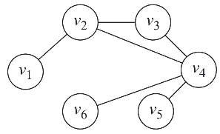
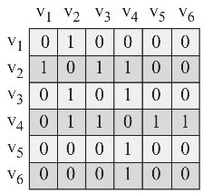
Degree Centrality in an Undirected Graph
1
1
1
1
1
1
1
3
2
4
1
1
=
A^{(nxn)}
x
1^{(n)}
Degree
centralities!

Slide 26
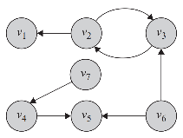
Out-Degree Centrality in a Directed Graph
The same idea still works: Multiply adjacency matrix A^{(nxn)} with 1^{(n)}, where n=|V|
Entry A_{i,j} of A indicates a directed edge from i to j
0 | 0 | 0 | 0 | 0 | 0 | 0
1 | 0 | 1 | 0 | 0 | 0 | 0
0 | 1 | 0 | 0 | 0 | 0 | 0
0 | 0 | 0 | 0 | 1 | 0 | 0
0 | 0 | 0 | 0 | 0 | 0 | 0
0 | 0 | 1 | 0 | 1 | 0 | 0
0 | 0 | 0 | 1 | 0 | 0 | 0

Slide 27
Entry A_{i,j} of A indicates a directed edge from i to j
Out-Degree Centrality in a Directed Graph
0 | 0 | 0 | 0 | 0 | 0 | 0
1 | 0 | 1 | 0 | 0 | 0 | 0
0 | 1 | 0 | 0 | 0 | 0 | 0
0 | 0 | 0 | 0 | 1 | 0 | 0
0 | 0 | 0 | 0 | 0 | 0 | 0
0 | 0 | 1 | 0 | 1 | 0 | 0
0 | 0 | 0 | 1 | 0 | 0 | 0
1
1
1
1
1
1
1
0
2
1
1
0
2
1
=
A^{(nxn)}
x
1^{(n)}
Out-degree
centralities

Slide 28
In-Degree Centrality in a Directed Graph
How? [Take the transpose of A]

Slide 29
0 | 0 | 0 | 0 | 0 | 0 | 0
1 | 0 | 1 | 0 | 0 | 0 | 0
0 | 1 | 0 | 0 | 0 | 0 | 0
0 | 0 | 0 | 0 | 1 | 0 | 0
0 | 0 | 0 | 0 | 0 | 0 | 0
0 | 0 | 1 | 0 | 1 | 0 | 0
0 | 0 | 0 | 1 | 0 | 0 | 0
0 | 1 | 0 | 0 | 0 | 0 | 0
0 | 0 | 1 | 0 | 0 | 0 | 0
0 | 1 | 0 | 0 | 0 | 1 | 0
0 | 0 | 0 | 0 | 0 | 0 | 1
0 | 0 | 0 | 1 | 0 | 1 | 0
0 | 0 | 0 | 0 | 0 | 0 | 0
0 | 0 | 0 | 0 | 0 | 0 | 0
Flip across the diagonal
A
A^{T}

Slide 30
In-Degree Centrality in a Directed Graph
Take the transpose of A, you’ll get A^{T} where A^{T}_{i,j} = A_{j,i}
Multiply A^{T} with 1
0 | 1 | 0 | 0 | 0 | 0 | 0
0 | 0 | 1 | 0 | 0 | 0 | 0
0 | 1 | 0 | 0 | 0 | 1 | 0
0 | 0 | 0 | 0 | 0 | 0 | 1
0 | 0 | 0 | 1 | 0 | 1 | 0
0 | 0 | 0 | 0 | 0 | 0 | 0
0 | 0 | 0 | 0 | 0 | 0 | 0

Slide 31
Entry A^{T}_{i,j} now denotes an edge coming towards i from j
In-Degree Centrality in a Directed Graph
1
1
1
1
1
1
1
1
1
2
1
2
0
0
0 | 1 | 0 | 0 | 0 | 0 | 0
0 | 0 | 1 | 0 | 0 | 0 | 0
0 | 1 | 0 | 0 | 0 | 1 | 0
0 | 0 | 0 | 0 | 0 | 0 | 1
0 | 0 | 0 | 1 | 0 | 1 | 0
0 | 0 | 0 | 0 | 0 | 0 | 0
0 | 0 | 0 | 0 | 0 | 0 | 0
=
A^{T}
x
1^{(n)}
In-degree
centralities

Slide 32
Summary of Degree Centralities
Undirected graph: Ax1
Directed graph, out-degree centralities: Ax1
Directed graph, in-degree centralities: A^{T}x1
Where A denotes the adjacency matrix of dimension (nxn), and 1 represents a vector of all 1’s of dimension n.

Slide 33
A quick recap of Eigenvalues and Eigenvectors
What does y = Ax mean?
Intuition: You have a vector x^{(n)}. The matrix A^{(nxn)} works like an operator on x to scale and rotate the vector x to produce a new vector y^{(n)}.

Slide 34
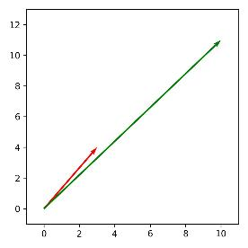
A quick recap of Eigenvalues and Eigenvectors
What does y = Ax mean?
Intuition: You have a vector x^{(n)}. The matrix A^{(nxn)} works like an operator on x to scale and rotate the vector x to produce a new vector y^{(n)}.
Example:
y = (10,11)
2 | 1
1 | 2
3
4
10
11
x
=
x = (3,4)
A^{(2x2)}
x⁽²⁾
y⁽²⁾

Slide 35
A quick recap of Eigenvalues and Eigenvectors
What does y = Ax mean?
Intuition: You have a vector x^{(n)}. The matrix A^{(nxn)} works like an operator on x to scale and rotate the vector x to produce a new vector y^{(n)}.
Example:
y = (10,11)
2 | 1
1 | 2
3
4
10
11
x
=
x = (3,4)
A^{(2x2)}
x⁽²⁾
y⁽²⁾
x got scaled and also a little rotated to become y

Slide 36
A quick recap of Eigenvalues and Eigenvectors
You have a vector x^{(n)}. The matrix A^{(nxn)} works like an operator on x to scale and rotate the vector x to produce a new vector y^{(n)}.
However, there are some special choices of the vector x, which, when Ax is carried out, do not get rotated and only get scaled by A

Slide 37
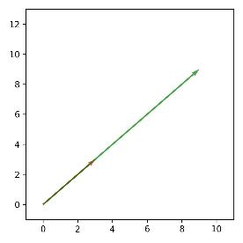
A quick recap of Eigenvalues and Eigenvectors
You have a vector x^{(n)}. The matrix A^{(nxn)} works like an operator on x to scale and rotate the vector x to produce a new vector y^{(n)}.
However, there are some special choices of the vector x, which, when Ax is carried out, do not get rotated and only get scaled by A
2 | 1
1 | 2
y = (9,9)
3
3
9
9
x
=
x = (3,3)
A^{(2x2)}
x⁽²⁾
y⁽²⁾

Slide 38
A quick recap of Eigenvalues and Eigenvectors
These special vectors are called Eigenvectors associated with the matrix A, and each Eigenvector comes with a scaling factor called Eigenvalue λ
2 | 1
1 | 2
y = (9,9)
3
3
9
9
x
=
x = (3,3)
A^{(2x2)}
x⁽²⁾
y⁽²⁾

Slide 39
A quick recap of Eigenvalues and Eigenvectors
These special vectors are called Eigenvectors associated with the matrix A, and each Eigenvector comes with a scaling factor called Eigenvalue λ
Parallel to one of the Eigenvectors of A
2 | 1
1 | 2
y = (9,9)
3
3
9
9
x
=
x = (3,3)
A^{(2x2)}
x⁽²⁾
y⁽²⁾

Slide 40
A quick recap of Eigenvalues and Eigenvectors
These special vectors are called Eigenvectors associated with the matrix A, and each Eigenvector comes with a scaling factor called Eigenvalue λ
2 | 1
1 | 2
y = (9,9)
3
3
9
9
x
=
x = (3,3)
A^{(2x2)}
x⁽²⁾
y⁽²⁾
The vector x got scaled by a factor of 3 but didn’t rotate. Eigenvalue is 3.

Slide 41
Key Intuition
If we encounter a real life problem that can be expressed in the format λx = Ax, it will tells us that there are certain special choices of x (associated with A) that will only be scaled by a scalar factor λ and will not get rotated when operated on by A. Those special choice vectors are the Eigenvectors x. The matrix A determines what these Eigenvectors and Eigenvalues will be.
But how do we find the x and λ associated with A that satisfies this equation λx = Ax?

Slide 42
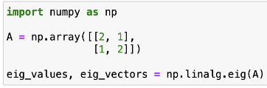
Key Intuition
If we encounter a real life problem that can be expressed in the format λx = Ax, it will tells us that there are certain special choices of x (associated with A) that will only be scaled by a scalar factor λ and will not get rotated when operated on by A. Those special choice vectors are the Eigenvectors x. The matrix A determines what these Eigenvectors and Eigenvalues will be.
But how do we find the x and λ associated with A that satisfies this equation λx = Ax?
Linear algebra class: You can do it by hand!
Python/MATLAB packages: Just give A as an input, all the x and λ choices that satisfy the equation will be computed for you.

Slide 43
The Linear Algebraic way of finding Eigenvectors and Eigenvalues (consult thy textbook for details 😐)
λx = Ax
x₁
x₂
2 | 1
1 | 2
λ
=
x₁
x₂
A is given. Find x and λ that satisfy λx = Ax

Slide 44
The Linear Algebraic way of finding Eigenvectors and Eigenvalues
x₁
x₂
2 | 1
1 | 2
λ
=
x₁
x₂
λx = Ax
⇒ Ax - λx = 0
2 | 1
1 | 2
x₁
x₂
x₁
x₂
-
λ
=
0
0

Slide 45
The Linear Algebraic way of finding Eigenvectors and Eigenvalues
x₁
x₂
2 | 1
1 | 2
λ
=
x₁
x₂
λx = Ax
⇒ Ax - λx = 0
⇒ Ax - λIx = 0
2 | 1
1 | 2
x₁
x₂
x₁
x₂
-
λ
=
0
0
2 | 1
1 | 2
x₁
x₂
1 | 0
0 | 1
x₁
x₂
-
λ
=
0
0

Slide 46
The Linear Algebraic way of finding Eigenvectors and Eigenvalues
2 | 1
1 | 2
x₁
x₂
1 | 0
0 | 1
x₁
x₂
-
λ
=
0
0
λx = Ax
⇒ Ax - λx = 0
⇒ Ax - λIx = 0
⇒ (A - λI)x = 0
(
)
2 | 1
1 | 2
1 | 0
0 | 1
x₁
x₂
-
λ
=
0
0

Slide 47
The Linear Algebraic way of finding Eigenvectors and Eigenvalues
2 | 1
1 | 2
x₁
x₂
1 | 0
0 | 1
x₁
x₂
-
λ
=
0
0
λx = Ax
⇒ Ax - λx = 0
⇒ Ax - λIx = 0
⇒ (A - λI)x = 0
(
)
2 | 1
1 | 2
1 | 0
0 | 1
x₁
x₂
-
λ
=
0
0
2-λ | 1-0
1-0 | 2-λ
x₁
x₂
=
0
0

Slide 48
The Linear Algebraic way of finding Eigenvectors and Eigenvalues
2-λ | 1
1 | 2-λ
x₁
x₂
=
0
0
λx = Ax
⇒ Ax - λx = 0
⇒ Ax - λIx = 0
⇒ (A - λI)x = 0
⇒ det(A-λI) = 0
Since x!=0, det(A-λI) must equal 0
(
)
2-λ | 1
1 | 2-λ
det
= 0
Notes:
2-4l+l2

Slide 49
The Linear Algebraic way of finding Eigenvectors and Eigenvalues
2-λ | 1
1 | 2-λ
x₁
x₂
=
0
0
λx = Ax
⇒ Ax - λx = 0
⇒ Ax - λIx = 0
⇒ (A - λI)x = 0
⇒ det(A-λI) = 0
Since x!=0, det(A-λI) must equal 0
(
)
2-λ | 1
1 | 2-λ
det
= 0
λ = 3, 1
Notes:
2-4l+l2

Slide 50
The Linear Algebraic way of finding Eigenvectors and Eigenvalues
λ = 3 (take the largest Eigenvalue)
λx = Ax
⇒ Ax - λx = 0
⇒ Ax - λIx = 0
⇒ (A - λI)x = 0
⇒ det(A-λI) = 0
⇒ take the largest λ
Notes:
2-4l+l2

Slide 51
The Linear Algebraic way of finding Eigenvectors and Eigenvalues
λ = 3 (take the largest Eigenvalue)
λx = Ax
⇒ Ax - λx = 0
⇒ Ax - λIx = 0
⇒ (A - λI)x = 0
⇒ det(A-λI) = 0
⇒ take the largest λ, find x
2-3 | 1
1 | 2-3
x₁
x₂
=
0
0
Solve for x, that is your Eigenvector
Notes:
2-4l+l2

Slide 52
Key Intuition Recap
If the problem can be expressed as λx = Ax, and we know the A, there are easy ways to find what x and λ will satisfy the equation.

Slide 53
Now, let’s talk about Eigenvector Centrality
Eigenvector Centrality: The measure of the extent to which a node is connected to influential other nodes

Slide 54
Eigenvector Centrality
Linda has the most influential friends, hence she is very influential => captured by Eigenvector Centrality
Data collected by Prof. David Krackhardt of Carnegie Mellon University

Slide 55
Eigenvector Centrality
We would like to compute a vector capturing that intuition, where the entries hold the respective node’s Eigenvector Centrality
Data collected by Prof. David Krackhardt of Carnegie Mellon University

Slide 56
Eigenvector Centrality
Having more friends isn’t sufficient, having important friends is the real deal
This is the intuition we would like to capture from our adjacency matrix, A

Slide 57
Eigenvector Centrality
Having more friends isn’t sufficient, having important friends is the real deal
Linda’s centrality, c_{e}(v_{i}) ∝ The sum of Linda’s peers’ centralities
By ‘centralities’, we mean Eigenvector centralities. We do not know the centrality values yet. But we know that this proportionality relation should be captured by the centrality values we arrive at. In other words, if Linda’s peers’ total centrality or importance is high, Linda should be awarded a high centrality as well, and vice versa.

Slide 58
Eigenvector Centrality
Having more friends isn’t sufficient, having important friends is the real deal
Linda’s centrality, c_{e}(v_{i}) ∝ The sum of Linda’s peers’ centralities
Linda’s centrality, c_{e}(v_{i}) ∝ sum( Linda’s incoming edges * centralities of the nodes attached to those edges)
Just expanding the idea

Slide 59
Eigenvector Centrality
Having more friends isn’t sufficient, having important friends is the real deal
Linda’s centrality, c_{e}(v_{i}) ∝ The sum of Linda’s peers’ centralities
Linda’s centrality, c_{e}(v_{i}) ∝ sum( Linda’s incoming edges * centralities of the nodes attached to those edges)
Linda’s centrality, c_{e}(v_{i}) ∝ sum_{j}( A_{j,i} * c_{e}(v_{j})), for j in {1,..,n}
Linda is the i^{th} node. This is her centrality (we are trying to compute this)

Slide 60
Eigenvector Centrality
Having more friends isn’t sufficient, having important friends is the real deal
Linda’s centrality, c_{e}(v_{i}) ∝ The sum of Linda’s peers’ centralities
Linda’s centrality, c_{e}(v_{i}) ∝ sum( Linda’s incoming edges * centralities of the nodes attached to those edges)
Linda’s centrality, c_{e}(v_{i}) ∝ sum_{j}( A_{j,i} * c_{e}(v_{j})), for j in {1,..,n}
A_{j,i} = 1 when node j is Linda’s peer (i.e., j has an edge toward i ). For non-peers, A_{j,i} = 0 , so there will be no contribution to the sum.

Slide 61
Eigenvector Centrality
Having more friends isn’t sufficient, having important friends is the real deal
Linda’s centrality, c_{e}(v_{i}) ∝ The sum of Linda’s peers’ centralities
Linda’s centrality, c_{e}(v_{i}) ∝ sum( Linda’s incoming edges * centralities of the nodes attached to those edges)
Linda’s centrality, c_{e}(v_{i}) ∝ sum_{j}( A_{j,i} * c_{e}(v_{j})), for j in {1,..,n}
This is peer j’s centrality. We are trying to compute this as well.

Slide 62
Eigenvector Centrality
Having more friends isn’t sufficient, having important friends is the real deal
Linda’s centrality, c_{e}(v_{i}) ∝ The sum of Linda’s peers’ centralities
Linda’s centrality, c_{e}(v_{i}) ∝ sum( Linda’s incoming edges * centralities of the nodes attached to those edges)
Linda’s centrality, c_{e}(v_{i}) ∝ sum_{j}( A_{j,i} * c_{e}(v_{j})), for j in {1,..,n}
Take the sum over all nodes. Obviously, only the incoming edges from Linda’s real peers will have anything to contribute to this sum

Slide 63
Eigenvector Centrality
Having more friends isn’t sufficient, having important friends is the real deal
Linda’s centrality, c_{e}(v_{i}) ∝ The sum of Linda’s peers’ centralities
Linda’s centrality, c_{e}(v_{i}) ∝ sum( Linda’s incoming edges * centralities of the nodes attached to those edges)
Linda’s centrality, c_{e}(v_{i}) ∝ sum_{j}( A_{j,i} * c_{e}(v_{j})), for j in {1,..,n}
Take the sum over all nodes. Obviously, only the incoming edges from Linda’s real peers will have anything to contribute to this sum
Notice that Linda’s centrality depends on her friends’ total centrality. But her friends’ centralities also depend on Linda’s centrality. This recursive nature makes the problem difficult.

Slide 64

Eigenvector Centrality
Having more friends isn’t sufficient, having important friends is the real deal
Linda’s centrality, c_{e}(v_{i}) ∝ The sum of Linda’s peers’ centralities
Linda’s centrality, c_{e}(v_{i}) ∝ sum( Linda’s incoming edges * centralities of the nodes attached to those edges)
Linda’s centrality, c_{e}(v_{i}) ∝ sum_{j}( A_{j,i} * c_{e}(v_{j})), for j in {1,..,n}
∝
Same thing. Screenshot from the textbook.

Slide 65
Eigenvector Centrality
Having more friends isn’t sufficient, having important friends is the real deal
Linda’s centrality, c_{e}(v_{i}) ∝ The sum of Linda’s peers’ centralities
Linda’s centrality, c_{e}(v_{i}) ∝ sum( Linda’s incoming edges * centralities of the nodes attached to those edges)
Linda’s centrality, c_{e}(v_{i}) ∝ sum_{j}( A_{j,i} * c_{e}(v_{j})), for j in {1,..,n}
∝
We can replace the proportional sign with any scalar proportionality constant

Slide 66

Eigenvector Centrality
Having more friends isn’t sufficient, having important friends is the real deal
Linda’s centrality, c_{e}(v_{i}) ∝ The sum of Linda’s peers’ centralities
Linda’s centrality, c_{e}(v_{i}) ∝ sum( Linda’s incoming edges * centralities of the nodes attached to those edges)
Linda’s centrality, c_{e}(v_{i}) ∝ sum_{j}( A_{j,i} * c_{e}(v_{j})), for j in {1,..,n}
∝
Rewriting the same equation compactly. λ has been taken to the other side of the equal sign. A_{j,i} are the entries of A^{T}, as discussed before. All the c_{e}(v_{i}) values are captured in the vector c_{e}, where the entries correspond to the centralities of the respective nodes. But how do we calculate this vector c_{e}?

Slide 67
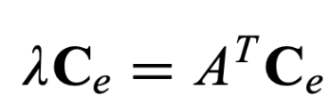
Looks like our problem can be expressed in the λx = Ax format
The equation tells us that for certain special choices of c_{e}, the operator matrix (A^{T} in this case) will not rotate this vector c_{e}, rather only scale it by a factor of λ.
And we also know how to compute this vector c_{e} when we know the operator matrix! Use linear algebra wizardry.

Slide 68
Eigenvector Centrality
We know the Adjacency Matrix, A
Take the transpose to get A^{T}
Find the largest Eigenvalue for A^{T}
Find the Eigenvector corresponding to the largest Eigenvalue
This Eigenvector holds the ‘Eigenvector Centralities’ for all the nodes!

Slide 69
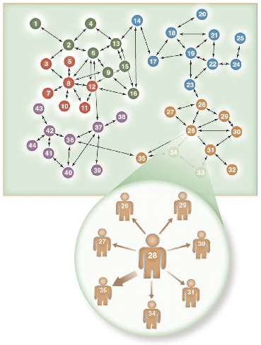
Readings
Chapters 3.1.1-3.1.6 (inclusive) of the textbook
Valente, Thomas W. "Network interventions." Science 337.6090 (2012): 49-53.
Roberts, Nancy, and Sean F. Everton. "Strategies for combating dark networks." Journal of Social Structure 12.1 (2011): 1-32.
Feld, Scott L. "Why your friends have more friends than you do." American Journal of Sociology 96.6 (1991): 1464-1477.

Slide 70
Summary

